Slide 1
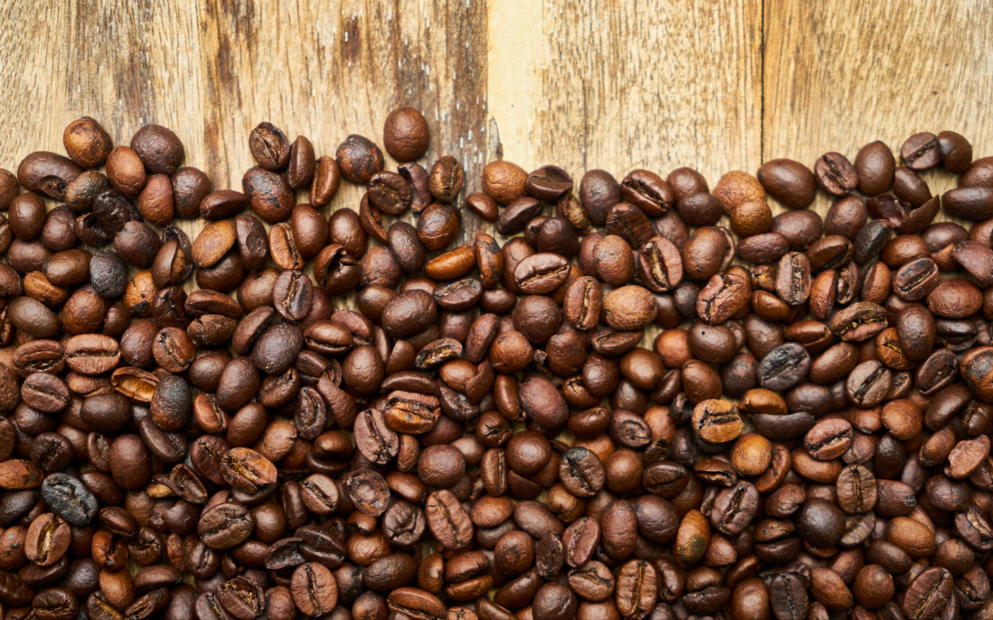
IST 718 Project: Coffee Bean Analysis
Tim Cordero

Slide 2


Specification
What factors go into making a high-quality coffee bean
What type of coffee bean is the most popular
What area produces the most and the best coffee beans
Predict a coffee bean based on user preference inputs

Slide 3
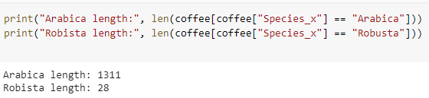
Observation
Data was a bit messy in its original format
The same columns were named different in Arabica and Robusta datasets
Arabica dataset contained one bean without a corresponding record for ratings
Substantially more observations for Arabica compared to Robusta
Some columns contain missing values

Slide 4
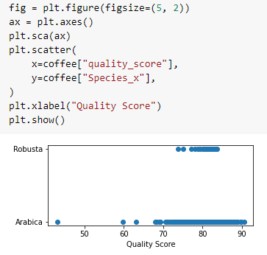
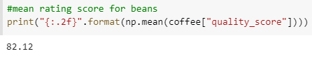
Observation (Cont’d)

Slide 5

Analysis
Planned modeling techniques
Correlation for numerical fields with quality score
Regression model(s) for quality score prediction based off correlated fields
Create discretized quality score
Classification model(s) predicting discretized quality score

Slide 6
Recommendation
Obtain
Complete. Data obtained from jldbc/coffee-quality-database: Building the Coffee Quality Institute Database (github.com), which originated from the Coffee Quality Institute Database
Scrub
Complete for now. Both Arabica and Robusta Datasets were joined into one comprehensive data frame and cleaned as necessary. May still need to remove or replace missing values
Explore
Not finished, still need to explore the data more thoroughly as well as create more visualizations
Model
Not started, still need to create models and tune appropriately
Interpret
Not started, still need to build models and interpret visualizations and models

Slide 7
Thank You!

